Slide 1
Computer Organisation
Topic 3
Computer Arithmetic
Stallings, Computer Organization & Architecture (9th Ed.), Chap. 10

Slide 2




Outline
Arithmetic & Logic Unit
Integer Representation
Sign-magnitude
Twos complement
Conversion between lengths
Integer Arithmetic
Floating-point Arithmetic
Addition & Subtraction
Multiplication
Division

Slide 3




Learning objectives
Understand the distinction between the way in which numbers are represented (the binary format) and the algorithms used for the basic arithmetic operations.
Explain twos complement representation.
Present an overview of the techniques for doing basic arithmetic operations in twos complement notation.
Understand the use of significand, base, and exponent in the representation of floating-point numbers.

Slide 4

Arithmetic & Logic Unit
A vital component of the CPU responsible for executing arithmetic and logical instructions
A fundamental part of a computer's processing capabilities
Other elements of the computer system (CU, registers, memory) mainly to bring data into the ALU for it to process and then to take the results back out
Does the calculations
Everything else in the computer is there to service this unit
Image source: https://www.wannapik.com/vectors/10124
Notes:
4
Computer arithmetic is commonly performed on two very different types of numbers: integer and floating point.
In both cases, the representation chosen is a crucial design issue and is treated first, followed by a discussion of arithmetic operations
All of the other elements of the computer system—control unit, registers, memory, I/O—are there mainly to bring data into the ALU for it to process
and then to take the results back out. We have, in a sense, reached the core or essence of a computer when we consider the ALU.
An ALU and indeed, all electronic components in the computer, are based on the use of simple digital logic devices that can store binary digits and perform simple Boolean logic operations

Slide 5
Arithmetic & Logic Unit
Handles integers
May handle floating point (real) numbers
Notes:
5

Slide 6
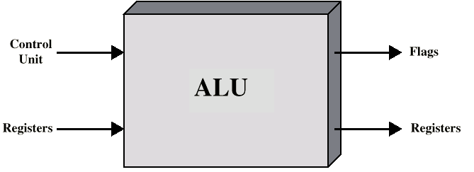
ALU Inputs and Outputs
Image source: https://www.wannapik.com/vectors/10124
Notes:
6
how the ALU is interconnected with the rest of the processor. Operands for arithmetic and logic operations are presented to the ALU in registers, and the results of an operation are stored in registers. These registers are temporary storage locations within the processor that are connected by signal paths to the ALU
The ALU may also set flags as the result of an operation. For example, an overflow flag is set to 1 if the result of a computation exceeds the length of the register into which it is to be stored
The flag values are also stored in registers within the processor. The processor provides signals that control the operation of the ALU and the movement of the data into and out of the ALU

Slide 7
Outline
Arithmetic & Logic Unit
Integer Representation
Sign-magnitude
Twos complement
Conversion between lengths
Integer Arithmetic
Floating-point Arithmetic
Addition & Subtraction
Multiplication
Division

Slide 8
Integer Representation
The way in which whole numbers (integers) are represented in a digital computer/binary system
Only have 0 & 1 to represent everything
Positive numbers stored in binary
e.g. 41=00101001
Binary digit or a ????
Bit
Notes:
8
In the binary number system,1 arbitrary numbers can be represented with just the digits zero and one, the minus sign (for negative numbers), and the period, or radix
point (for numbers with a fractional component).

Slide 9
Data Representation
Magnitude
Complement
Unsigned
1’s complement
(+ve)
(+ve) & (-ve)
Signed
2’s complement
(+ve) & (-ve)
(+ve) & (-ve)
In all representation, (+) number is represented in the same way

Slide 10
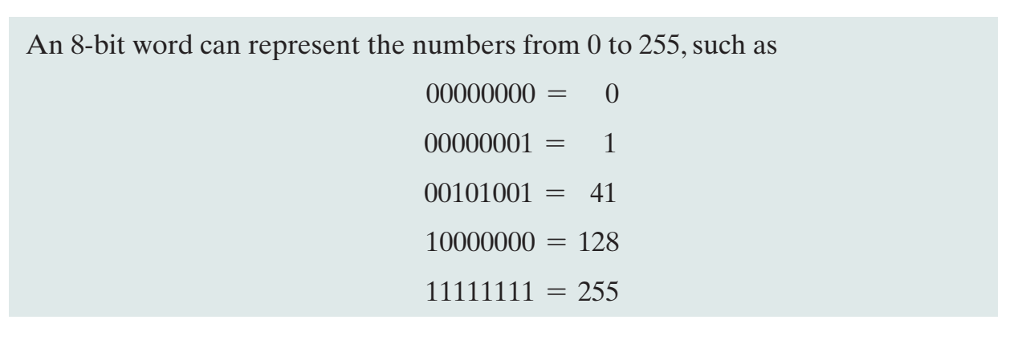
Integer Representation
In the binary system, number system can be represented with just the digits 0 and 1
No minus sign, no period, no radix point
Two ways:
Sign-Magnitude
Two’s complement
Notes:
10
For purposes of computer storage and processing, however, we do not have the benefit of special symbols for the minus sign and radix point. Only binary digits (0 and
1) may be used to represent numbers. If we are limited to nonnegative integers, the representation is straightforward.

Slide 11
Data Representation
Magnitude
Complement
Unsigned
1’s complement
(+ve)
(+ve) & (-ve)
Signed
2’s complement
(+ve) & (-ve)
(+ve) & (-ve)
In all representation, (+) number is represented in the same way
Notes:
Sign-Magnitude Representation
There are several alternative conventions used to represent negative as well as positive integers, all of which involve treating the most significant (leftmost) bit in the word as a sign bit.
If the sign bit is 0, the number is positive; if the sign bit is 1, the number is negative.
The simplest form of representation that employs a sign bit is the sign-magnitude representation.

Slide 12

Unsigned magnitude
Represents positive integers
Position | 2⁷ | 2⁶ | 2⁵ | 2⁴ | 2³ | 2² | 2¹ | 2⁰
Bit Pattern | 1 | 0 | 0 | 1 | 1 | 1 | 0 | 1
Weight | 128 | 64 | 32 | 16 | 8 | 4 | 2 | 1
10011101 = unsigned representation of 157

Slide 13
Unsigned magnitude
Only accept positive numbers
In computer programming, the unsigned integers property open for application in most numeric data types:
Short
Long
Int
Char

Slide 14
Advantages and disadvantages of unsigned magnitude
Advantages
One representation of zero
Simple addition
Disadvantages
Negative numbers cannot be represented
The need of different notation to represent negative numbers

Slide 15
Is a representation of negative numbers possible?
Unfortunately,
You cannot just stick a negative sign in front of a binary number (it does not work like that)
There are three methods used to represent negative numbers:
Signed magnitude notation
1s complement notation
2s complement notation

Slide 16
Signed-magnitude
Human use the signed-magnitude system.
We add + or – to the front of a number to indicate its sign
We can do this in binary too! By adding a sign bit in front of our numbers.

Slide 17
Signed-Magnitude
Use one-bit to represent the sign of the integer
Left most bit (Most Significant Bit, MSB) is sign bit
0 means positive
1 means negative
+18 = 00010010
-18 = 10010010
Notes:
17
In signed magnitude representation, a number is represented by two parts: a sign bit and a magnitude (or absolute value) part. The sign bit indicates whether the number is positive or negative, with 0 typically representing positive and 1 representing negative. The magnitude part represents the absolute value of the number.

Slide 18
Signed-Magnitude
0 = (+)
+6 =
0
110
1 = (-)
Magnitude
-6 =
1
110
Sign bit
Most significant bit (MSB)
Notes:
18

Slide 19
Signed-Magnitude
0 = (+)
1 = (-)
+13 =
0
1101
-13 =
1
1101
Notes:
19

Slide 20

Signed-magnitude
Suppose 10011101 is a signed magnitude representation.
The sign bit is 1, then the number represented is negative
Position | 2⁷ | 2⁶ | 2⁵ | 2⁴ | 2³ | 2² | 2¹ | 2⁰
Bit Pattern | 1 | 0 | 0 | 1 | 1 | 1 | 0 | 1
Weight |  |  |  | 16 | 8 | 4 |  | 1
The magnitude is 0011101 with a value of 2⁴+ 2³ 2²+ 2⁰ = 29
Then, the number represented by 10011101 is -29.

Slide 21
Signed-Magnitude Range
The range of signed magnitude representation depends on the number of bits used for both the sign bit and the magnitude part
Sign Bit part: 1 bit (1 for negative, 0 for positive)
Magnitude Part: (n-1) bits (assuming 1 bit is used for the sign)
The range of values that can be represented in signed magnitude representation with n bits is typically:
Range of signed magnitude = - (2^{n-1} -1) to +(2^{n-1} -1)
n = number of bit
Notes:
21

Slide 22
Signed-Magnitude Range
n = number of bit
- (2^{n-1} -1) to +(2^{n-1} -1)
Example:
n = 4
- (2⁴⁻¹ -1) to +(2⁴⁻¹ -1)
Answer:
The signed magnitude for 4 bit are between:
- (2³ -1) to +(2³ -1)
- (2³ -1) to +(2³ -1)
- (7) to + (7)
- (8 -1) to +(8 -1)
Notes:
22

Slide 23

Drawbacks of sign-magnitude
Addition and subtraction require a consideration of both the signs of the numbers and their relative magnitudes to carry out the required operation.
They are two representations of 0
To test if a number is 0 or not, the CPU will need to see whether it is 00000000 or 10000000.
Therefore, having 2 representation of 0 is inconvenient.
00000000 = +0₁₀
10000000 = -0₁₀

Slide 24
Quick Activity #1
37₁₀ has 00100101 is signed magnitude notation. Find the signed magnitude of -37₁₀.
Using the signed magnitude notation find the 8-bit binary representation of the decimal value 24₁₀ and -24₁₀.
Find the signed magnitude of –63 using 8-bit binary sequence?

Slide 25
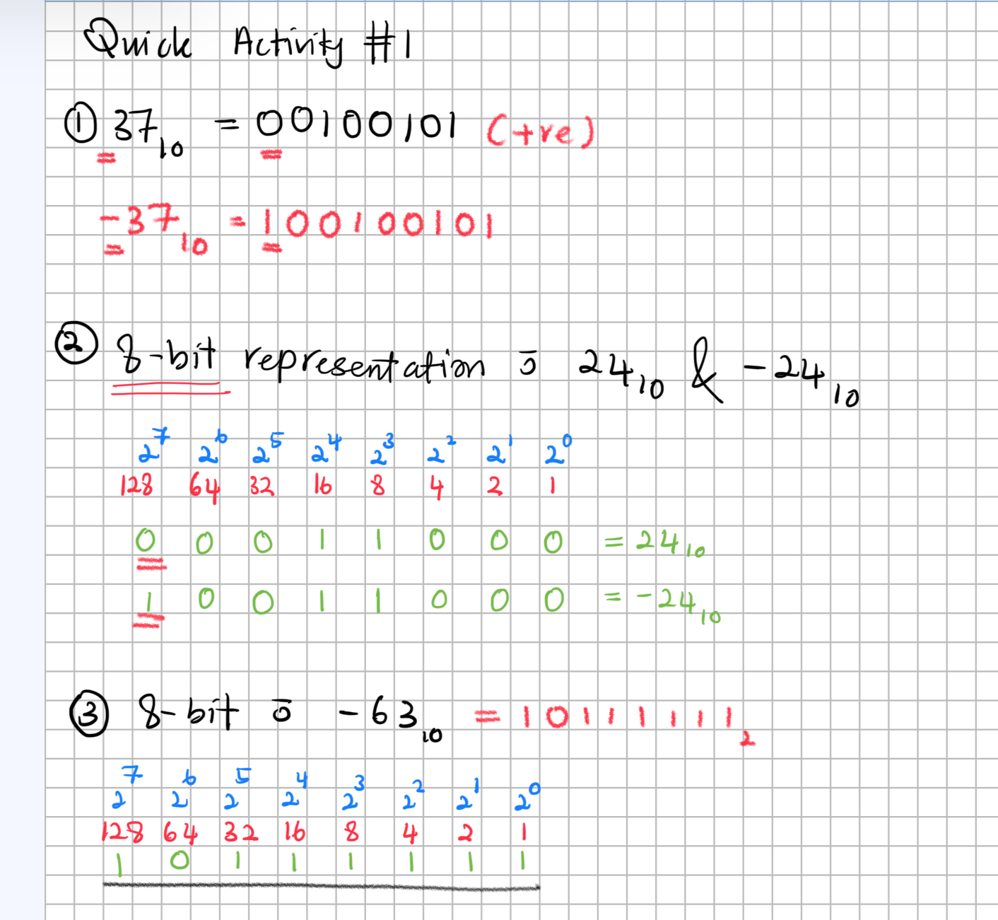
1010010

Slide 26
Data Representation
Magnitude
Complement
Unsigned
1’s complement
(+ve)
(+ve) & (-ve)
Signed
2’s complement
(+ve) & (-ve)
(+ve) & (-ve)
In all representation, (+) number is represented in the same way

Slide 27
1s complement
In a different representation, 1s complement, we negate numbers by complementing each bit of the number.
We keep the sign bits; 0 for positive and 1 for negative
The sign bit is complemented along with the rest of the bits

Slide 28
1’s complement
Negative numbers are represented by taking the bitwise complement (inverting all the bits) of the positive binary representation of the number
(1010)₂ = (0101)₂

Slide 29
2’s complement
2's complement is a binary representation method used in computers to represent signed integers (both positive and negative numbers).
It is the most common method for representing signed integers
2’s complement requires 2 rules:
Rule 1
Find 1’s complement for the integer
Rule 2
Add 1 to the 1’s complement

Slide 30
2’s complement
Step 1: Find 1’s complement for the integer
Step 2: Add 1 to the 1’s complement
Example:
(10111010)₂
Step 1
01000101
1
Step 2
01000101
⁺
1
0 + 0 = 0
0 + 1 = 1
1 + 0 = 1
1 + 1 = 0 carry forward 1
0
1
0
0
0
1
1
0

Slide 31
2’s complement (Alt)
+3 = 00000011
+2 = 00000010
+1 = 00000001
+0 = 00000000
-1 = 11111111
-2 = 11111110
-3 = 11111101
1
Most significant bit (MSB) is sign bit
(Left)
2
One representation of zero
= 1’s complement
3
Add 1 to LSB
(Right)

Slide 32
2’s complement
1
+3 = 00000011
+3 = 00000011
+2 = 00000010
+1 = 00000001
+0 = 00000000
-1 = 11111111
-2 = 11111110
-3 = 11111101
2
1’s complement
11111100
3
Add 1 to LSB
11111101

Slide 33
2’s complement (Alt)
+3 = 00000011
+2 = 00000010
+1 = 00000001
+0 = 00000000
-1 = 11111111
-2 = 11111110
-3 = 11111101
1
Identify the LSB and copy all zeros until the first 1
2
Copy the first 1
3
Complement all the remaining bits (after 1)

Slide 34
2’s complement
1
+3 = 00000011
+3 = 00000011
+2 = 00000010
+1 = 00000001
+0 = 00000000
-1 = 11111111
-2 = 11111110
-3 = 11111101
2
11111101

Slide 35
Quick Activity #2
01001₂
01011₂
00111₂
00001₂
Notes:
10111₂
10101₂
11001₂
11111₂

Slide 36
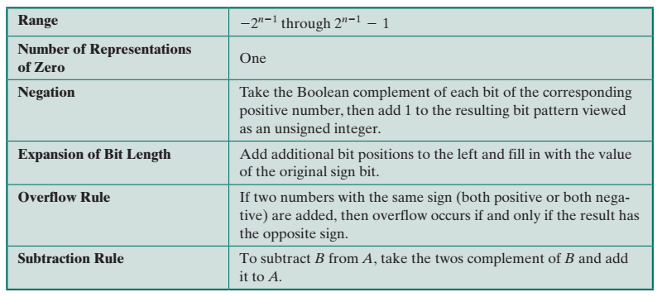
Characteristics of 2’s Complement Representation
n = number of bit
- (2^{n-1}) to +(2^{n-1} -1)

Slide 37
Advantages of 2’s complement
It eliminates the need for two representations of zero, resulting in a unique representation.
Arithmetic operations like addition, subtraction, and multiplication are simplified, and there are no issues with end-around carries.
The representation is symmetric, meaning the range of positive and negative values is evenly distributed around zero.
It's widely supported and used in modern computer systems due to its efficiency in arithmetic operations and other benefits.

Slide 38
Advantages of 2’s complement
Subtraction can be easily performed
Multiplication is just a repeated addition
Division is just a repeated subtraction
2s complement is widely used in ALU

Slide 39
Converting Between 2’s Complement Binary To Decimal
Position | 2⁷ | 2⁶ | 2⁵ | 2⁴ | 2³ | 2² | 2¹ | 2⁰
Weight | 128 | 64 | 32 | 16 | 8 | 4 | 2 | 1
Bit Pattern
An eight-position 2’s complement value box
Notes:
The most negative 2s complement range is -(2^{n-1})
-(2⁸⁻¹)
-(2⁷)
-(128)
2. If any of the bits other than the sign bit is one, it adds a positive amount to the number
3. A negative number must have a 1 at its leftmost position and a positive number must have a 0 in that position.
4. Thus, the largest positive number is a 0 followed by all 1s, which equals 2n - 1 - 1.

Slide 40
Converting Between 2’s Complement Binary To Decimal
Example:
Convert binary 10000011 to decimal
128 | 64 | 32 | 16 | 8 | 4 | 2 | 1
1
0
0
0
0
0
1
1
-128
+2
+1
10000011 = -128 + 2 + 1
10000011 = -128 + 3
10000011 =-125
Notes:
The most negative 2s complement range is -(2^{n-1})
-(2⁸⁻¹)
-(2⁷)
-(128)
2. If any of the bits other than the sign bit is one, it adds a positive amount to the number
3. A negative number must have a 1 at its leftmost position and a positive number must have a 0 in that position.
4. Thus, the largest positive number is a 0 followed by all 1s, which equals 2n - 1 - 1.

Slide 41
Converting Between 2’s Complement Decimal To Binary
Example:
Convert decimal 120 to binary
128 | 64 | 32 | 16 | 8 | 4 | 2 | 1
0
1
1
1
1
0
0
0
+64
+32
+16
+8
64 + 32 + 16 + 8= 01111000
120 = 01111000
Notes:
The most negative 2s complement range is -(2^{n-1})
-(2⁸⁻¹)
-(2⁷)
-(128)
2. If any of the bits other than the sign bit is one, it adds a positive amount to the number
3. A negative number must have a 1 at its leftmost position and a positive number must have a 0 in that position.
4. Thus, the largest positive number is a 0 followed by all 1s, which equals 2n - 1 - 1.

Slide 42
Converting Between 2’s Complement Decimal To Binary
Example:
Convert decimal -120 to binary
-128 | 64 | 32 | 16 | 8 | 4 | 2 | 1
1
0
0
0
1
0
0
0
-128
+8
-128 + 8 = 10001000
-120 = 10001000
Notes:
The most negative 2s complement range is -(2^{n-1})
-(2⁸⁻¹)
-(2⁷)
-(128)
2. If any of the bits other than the sign bit is one, it adds a positive amount to the number
3. A negative number must have a 1 at its leftmost position and a positive number must have a 0 in that position.
4. Thus, the largest positive number is a 0 followed by all 1s, which equals 2n - 1 - 1.

Slide 43
In-class activity
Convert the following:
10100101
66
01101101
-80
128 | 64 | 32 | 16 | 8 | 4 | 2 | 1

Slide 44
Negation
In signed-magnitude representation, the rule for forming the negation of an integer is simple: invert the sign bit.
In twos complement notation, the negation of an integer can be formed with the following rules:
Find 1’s complement to the integer
Add 1 to 1’s complement integer

Slide 45
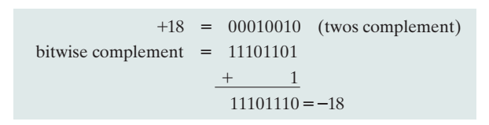
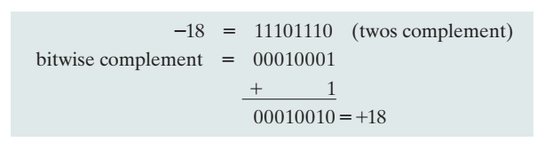
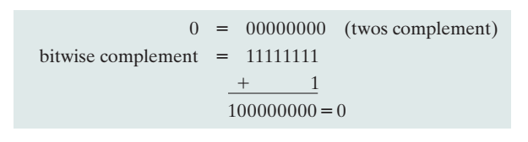
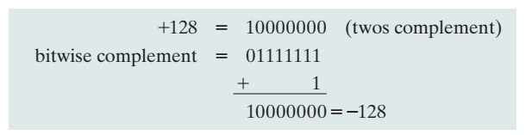

Slide 46
Quick Activity #3
Represent these numbers in 8-bit 2’s complement
+ 44
+ 89
+ 106
- 18
- 74
- 86
- 99
- 110
- 120
- 128

Slide 47
2’s complement operations
Addition
Subtraction
Multiplication
Division

Slide 48
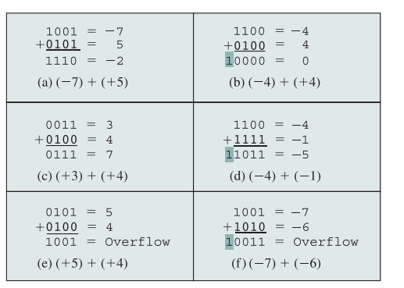
Addition in 2’s in complement

Slide 49
Addition and Subtraction
Addition proceeds as if the two numbers were unsigned integers
If the result of the operation is positive, we get a positive number in 2’s complement form, which is the same as in unsigned integer form
If the result of the operation is negative, we get a negative number in 2’s complement form
In some instances, there is a carry bit beyond the end of the word (indicated by shading), which is ignored
On any addition, the result may be larger than can be held in the word size being used = OVERFLOW
When overflow occurs, the ALU must signal this fact so that no attempt is made to use the result

Slide 50
Overflow rule
0 +
1-
If two numbers are added, and they are both positive or both negative, then overflow occurs if and only if the result has the opposite sign.
(+) + (+) = (-)
Sign bit
(-) + (-) = (+)

Slide 51
Rules of Binary Arithmetic
Binary Addition
0 + 0 = 0
0 + 1 = 1
1 + 0 = 1
1 + 1 = 0 Sum of 0 with a carry of 1
Binary Multiplication
0 × 0 = 0
0 × 1 = 0
1 × 0 = 0
1 × 1 = 1
Binary Subtraction
0 – 0 = 0
1 – 0 = 1
1 – 1 = 0
0 = 1 = 1 (Borrow 1)

Slide 52
Addition (Example 1)
Add two 4-bits 2’s complement of 4 and 3
Step 1 – Convert 4 and 3 to binary
 | 128 | 64 | 32 | 16 | 8 | 4 | 2 | 1
4 |  |  |  |  | 0 | 1 | 0 | 0
3 |  |  |  |  | 0 | 0 | 1 | 1
Step 2 – Perform binary addition
4 |  |  |  |  | 0 | 1 | 0 | 0
3 |  |  |  |  | 0 | 0 | 1 | 1
 |  |  |  |  | 0 | 1 | 1 | 1
Answer: 4 + 3 = 7 = 0111

Slide 53
Addition (Example 2)
Add two 5-bit 2’s complement of 13 and -6
Step 1 – Convert 13 and -6 to binary
 | 128 | 64 | 32 | 16 | 8 | 4 | 2 | 1
13 |  |  |  | 0 | 1 | 1 | 0 | 1
In 2s complement
 | 128 | 64 | 32 | 16 | 8 | 4 | 2 | 1
+6 |  |  |  | 0 | 0 | 1 | 1 | 0
-6 |  |  |  | 1 | 1 | 0 | 1 | 0
Step 2 – Perform binary addition
13 |  |  | 0 | 1 | 1 | 0 | 1
-6 |  |  | 1 | 1 | 0 | 1 | 0
 |  | 1 | 0 | 0 | 1 | 1 | 1
Answer: 13 + (-6) = 7 = 00111
Notes:
To subtract B from A, take the 2s complement of B and add it to A.

Slide 54
Addition (Example 3)
Add two 5-bit 2’s complement of -15 and 9
In 2s complement
Step 1 – Convert -15 and 9 to binary
 | 128 | 64 | 32 | 16 | 8 | 4 | 2 | 1
+15 |  |  |  | 0 | 1 | 1 | 1 | 1
-15 |  |  |  | 1 | 0 | 0 | 0 | 1
 | 128 | 64 | 32 | 16 | 8 | 4 | 2 | 1
9 |  |  |  | 0 | 1 | 0 | 0 | 1
Step 2 – Perform binary addition
15 |  |  | 1 | 0 | 0 | 0 | 1
-6 |  |  | 0 | 1 | 0 | 0 | 1
 |  |  | 1 | 1 | 0 | 1 | 0
Answer: -15 + 9= -6 = 11010
Notes:
To subtract B from A, take the 2s complement of B and add it to A.

Slide 55
Addition (Example 4)
Add two 8-bit 2’s complement of -39 and 92
In 2s complement
Step 1 – Convert -39 and 92 to binary
 | 128 | 64 | 32 | 16 | 8 | 4 | 2 | 1
+39 | 0 | 0 | 1 | 0 | 0 | 1 | 1 | 1
-39 | 1 | 1 | 0 | 1 | 1 | 0 | 0 | 1
 | 128 | 64 | 32 | 16 | 8 | 4 | 2 | 1
92 | 0 | 1 | 0 | 1 | 1 | 1 | 0 | 0
Step 2 – Perform binary addition
-39 | 1 | 1 | 0 | 1 | 1 | 0 | 0 | 1
92 | 0 | 1 | 0 | 1 | 1 | 1 | 0 | 0
1 | 0 | 0 | 1 | 1 | 0 | 1 | 0 | 1
Answer: -39 + 92= 53= 00110101
Notes:
To subtract B from A, take the 2s complement of B and add it to A.

Slide 56
Addition (Example 5)
Add two 5-bit 2’s complement of -8 and -4
Step 1 – Convert -8 and -4 to binary
128 | 64 | 32 | 16 | 8 | 4 | 2 | 1
+8 |  |  | 0 | 1 | 0 | 0 | 0
-8 |  |  | 1 | 1 | 0 | 0 | 0
+4 |  |  | 0 | 0 | 1 | 0 | 0
-4 |  |  | 1 | 1 | 1 | 0 | 0
Step 2 – Perform binary addition
-8 |  |  | 1 | 1 | 0 | 0 | 0
-4 |  |  | 1 | 1 | 1 | 0 | 0
 |  | 1 | 1 | 0 | 1 | 0 | 0
Answer: -8 + (-4)= -12 = 10100
Notes:
To subtract B from A, take the 2s complement of B and add it to A.

Slide 57
Addition (Example 4)
Overflow example
Add two 8-bit 2’s complement of 104 + 45
Step 1 – Convert 104 and 45 to binary
 | 128 | 64 | 32 | 16 | 8 | 4 | 2 | 1
104 | 0 | 1 | 1 | 0 | 1 | 0 | 0 | 0
45 | 0 | 0 | 1 | 0 | 1 | 1 | 0 | 1
Step 2 – Perform binary addition
104 | 0 | 1 | 1 | 0 | 1 | 0 | 0 | 0
45 | 0 | 0 | 1 | 0 | 1 | 1 | 0 | 1
 | 1 | 0 | 0 | 1 | 0 | 1 | 0 | 1
Answer: 104 + 45 = 149 = 10010101
Notes:
104 + 45 = 149 = 10010101

Slide 58
How do we handle overflow?
Since we added two positive numbers and got a negative result, overflow has indeed occurred. Therefore, this answer is not correct for 8-bit representation.
So, the correct answer cannot be represented within an 8-bit signed integer and would require a larger bit width (like 9 bits or more) to hold the value accurately.

Slide 59
Quick Activity #4
Assume numbers are represented in 8-bit twos-complement representation. Show the calculation of the following:
-19 + (-7)
44 + 45
-75 + 59
127 + 1
-1+1
-103 + (-69)

Slide 60
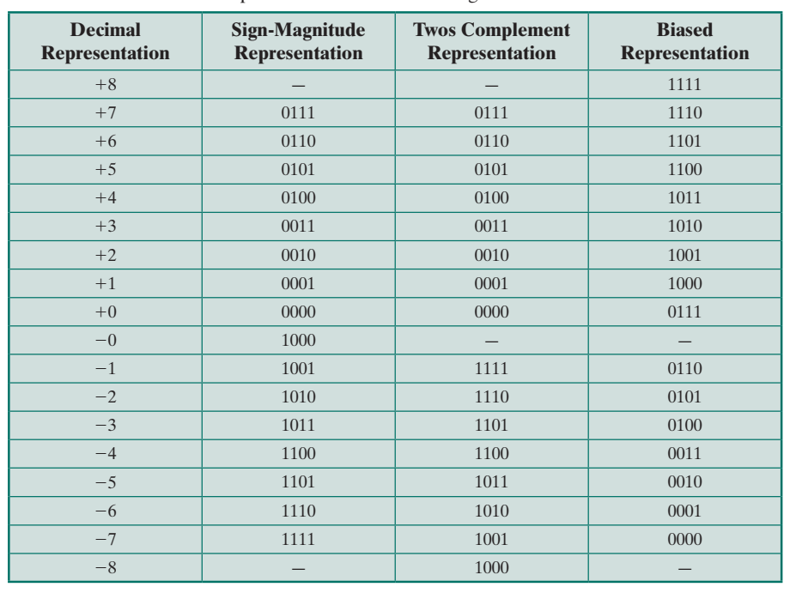

Slide 61
2’s complement operations
Addition
Subtraction
Multiplication
Division

Slide 62
Subtraction in 2’s complement
0 +
1-
To subtract one number (subtrahend) [S] from another (minuend) [M], take the 2s complement (negation) of the subtrahend and add them to the minuend
[M] + 2s [S]
Step 1: Find 2s complement of subtrahend [S]
Step 2: Perform the addition
Step 3: If the carry bit is generated and the result is positive, and in its true form
If carry bit is not produced, then the result is negative and in its 2s complement form
Notes:
If the carry bit is generated and the result is positive, and in its true form
If carry bit is not produced, then the result is negative and in its 2s complement form

Slide 63
Subtraction (Example 1)
Overflow example
M = 2
S = -7
Subtract two 4-bit 2’s complement of 2 and -7
Step 1 – Convert 2 and -7 to binary
M | 128 | 64 | 32 | 16 | 8 | 4 | 2 | 1
2 |  |  |  |  | 0 | 0 | 1 | 0
S | 128 | 64 | 32 | 16 | 8 | 4 | 2 | 1
7 |  |  |  |  | 0 | 1 | 1 | 1
-7 |  |  |  |  | 1 | 0 | 0 | 1
Step 2 – Perform binary addition
+2 |  |  |  |  | 0 | 0 | 1 | 0
+7 |  |  |  |  | 0 | 1 | 1 | 1
 |  |  |  |  | 1 | 0 | 0 | 1
Answer: 2 –(-7) = 2 + 7 = 9
Notes:
If the carry bit is generated and the result is positive, and in its true form
If the carry bit is generated and the result is negative, we ignore the carry bit
If carry bit is not produced, then the result is negative and in its 2s complement form

Slide 64
Subtraction (Example 2)
M = 5
S = -2
Subtract two 4-bit 2’s complement of 5 and -2
Step 1 – Convert 5 and -2 to binary
M | 128 | 64 | 32 | 16 | 8 | 4 | 2 | 1
5 |  |  |  |  | 0 | 1 | 0 | 1
S | 128 | 64 | 32 | 16 | 8 | 4 | 2 | 1
2 |  |  |  |  | 0 | 0 | 1 | 0
Step 2 – Perform binary addition
5 |  |  |  |  | 0 | 1 | 0 | 1
2 |  |  |  |  | 0 | 0 | 1 | 0
 |  |  |  |  | 0 | 1 | 1 | 1
Answer: 5 – (-2) = 5 + 2 = 7 = 0111
Notes:
If the carry bit is generated and the result is positive, and in its true form
If the carry bit is generated and the result is negative, we ignore the carry bit
If carry bit is not produced, then the result is negative and in its 2s complement form

Slide 65
Subtraction (Example 3)
Overflow example
Answer: 5 –(-3) = 5 +3 = 8
Subtract two 4-bit 2’s complement of 5 and -3
M =5
S =-3
Step 1 – Convert -5 and -2 to binary
M | 128 | 64 | 32 | 16 | 8 | 4 | 2 | 1
+5 |  |  |  |  | 0 | 1 | 0 | 1
S | 128 | 64 | 32 | 16 | 8 | 4 | 2 | 1
+3 |  |  |  |  | 0 | 0 | 1 | 1
Step 2 – Perform binary addition
+5 |  |  |  |  | 0 | 1 | 0 | 1
+3 |  |  |  |  | 0 | 0 | 1 | 1
 |  |  |  | 1 | 0 | 0 | 0 | 0
Notes:
If the carry bit is generated and the result is positive, and in its true form
If the carry bit is generated and the result is negative, we ignore the carry bit
If carry bit is not produced, then the result is negative and in its 2s complement form

Slide 66
Subtraction (Example 4)
M =5
S =2
Subtract two 4-bit 2’s complement of 5 and 2
Step 1 – Convert 5 and 2 to binary
M | 128 | 64 | 32 | 16 | 8 | 4 | 2 | 1
+5 |  |  |  |  | 0 | 1 | 0 | 1
+2 |  |  |  |  | 0 | 0 | 1 | 0
-2 |  |  |  |  | 1 | 1 | 1 | 0
Step 2 – Perform binary addition
5 |  |  |  |  | 0 | 1 | 0 | 1
-2 |  |  |  |  | 1 | 1 | 1 | 0
 |  |  |  | 1 | 0 | 0 | 1 | 1
Answer: 5 – (+2) = 5 – 2 = 3 = 0011
Notes:
If the carry bit is generated and the result is positive, and in its true form
If the carry bit is generated and the result is negative, we ignore the carry bit
If carry bit is not produced, then the result is negative and in its 2s complement form

Slide 67
Subtraction (Example 5)
M =7
S =7
Subtract two 4-bit 2’s complement of 7and 7
Step 1 – Convert 7 to binary
M | 128 | 64 | 32 | 16 | 8 | 4 | 2 | 1
7 |  |  |  |  | 0 | 1 | 1 | 1
-7 |  |  |  |  | 1 | 0 | 0 | 1
Step 2 – Perform binary addition
7 |  |  |  |  | 0 | 1 | 1 | 1
-7 |  |  |  |  | 1 | 0 | 0 | 1
 |  |  |  | 1 | 0 | 0 | 0 | 0
Answer: 7– 7= 0 = 10000
Notes:
To subtract B from A, take the 2s complement of B and add it to A.

Slide 68
Subtraction (Example 6)
Overflow example
M =7
S =-7
Subtract two 4-bit 2’s complement of 7and -7
Step 1 – Convert 7 to binary
M | 128 | 64 | 32 | 16 | 8 | 4 | 2 | 1
7 |  |  |  |  | 0 | 1 | 1 | 1
Step 2 – Perform binary addition
7 |  |  |  |  | 0 | 1 | 1 | 1
7 |  |  |  |  | 0 | 1 | 1 | 1
 |  |  |  |  | 1 | 1 | 1 | 0
Answer: 7–(-7) = 14 = 1110
Notes:
If the carry bit is generated and the result is positive, and in its true form
If the carry bit is generated and the result is negative, we ignore the carry bit
If carry bit is not produced, then the result is negative and in its 2s complement form

Slide 69
Subtraction (Example 3)
Overflow example
Answer: 5 – (-6) = 5 + 6 = 11
Subtract two 4-bit 2’s complement of 5 and -6
M =5
S =-6
Step 1 – Convert -5 and -2 to binary
M | 128 | 64 | 32 | 16 | 8 | 4 | 2 | 1
+5 |  |  |  |  | 0 | 1 | 0 | 1
S | 128 | 64 | 32 | 16 | 8 | 4 | 2 | 1
+6 |  |  |  |  | 0 | 1 | 1 | 0
Step 2 – Perform binary addition
+5 |  |  |  |  | 0 | 1 | 0 | 1
+6 |  |  |  |  | 0 | 1 | 1 | 0
 |  |  |  |  | 1 | 0 | 1 | 1
Notes:
If the carry bit is generated and the result is positive, and in its true form
If the carry bit is generated and the result is negative, we ignore the carry bit
If carry bit is not produced, then the result is negative and in its 2s complement form

Slide 70
Quick Activity #5
Assume numbers are represented in 8-bit twos-complement representation. Show the calculation of the following:
5 – 3
7 – 4
−6−2
12−(−5)
−7−(−8)
45−18
−50−25

Slide 71
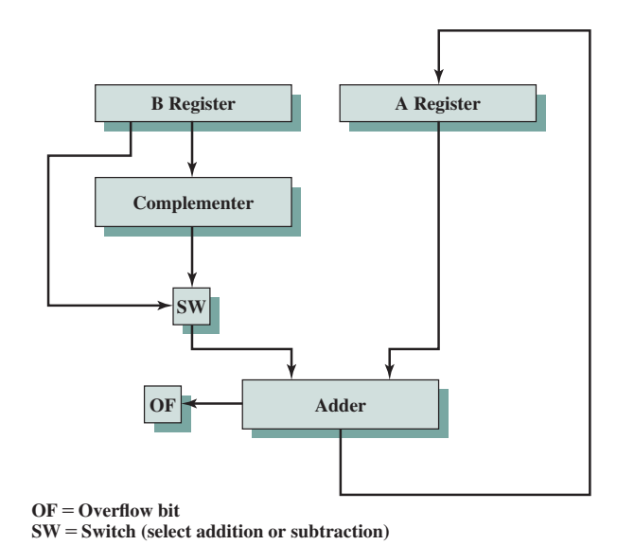
Hardware for Addition and Subtraction
Notes:
71
Figure suggests the data paths and hardware elements needed to accomplish addition and subtraction.
The central element is a binary adder, which is presented two numbers for addition and produces a sum and an overflow indication.
The binary adder treats the two numbers as unsigned integers.
For addition, the two numbers are presented to the adder from two registers, designated in this case as A and B registers.
The result may be stored in one of these registers or in a third.
The overflow indication is stored in a 1-bit overflow flag (0 = no overflow; 1 = overflow). For subtraction, the subtrahend (B register) is passed through a twos complementer so that its twos complement is presented to the adder.
Control signals are needed to control whether or not the complementer is used, depending on whether the operation is addition or subtraction.

Slide 72
+---------------------------------+
| Arithmetic Unit |
+----------------+----------------+
|
+------------+------------+
| |
+---+---+ +---+---+
| | | |
| Adder | |Subtractor|
| | | |
+---+---+ +---+---+
| |
+---+---+ +---+---+
| | | |
| Input | | Input |
| Ports | | Ports |
| | | |
+---+---+ +---+---+
| |
+---+------------------------+---+
| Multiplexer |
+----------------+---------------+
|
+---+---+
| Output |
| Port |
+---+---+
The control signals for the multiplexer determine whether the arithmetic unit performs addition or subtraction.
The output of the selected operation is then passed to the output port.
This basic hardware setup can be expanded and optimized for more complex arithmetic operations and can be part of a larger CPU or digital processing system.
Notes:
Arithmetic Unit: This is the main processing unit responsible for performing addition and subtraction operations. It consists of both an adder and a subtractor.
Adder: The adder is a component that performs addition operations. It takes input from input ports and produces the sum as output.
Subtractor: The subtractor is a component that performs subtraction operations. It also takes input from input ports and produces the difference as output.
Input Ports: These are the interfaces through which the numbers to be added or subtracted are provided to the arithmetic unit.
Multiplexer: The multiplexer is used to select whether to perform addition or subtraction based on the control signals. It directs the input to either the adder or the subtractor.
Output Port: This is the interface through which the result of the addition or subtraction operation is outputted.

